Slide 1
Pump it up!!!!
Data Mining the Water Table

Slide 2
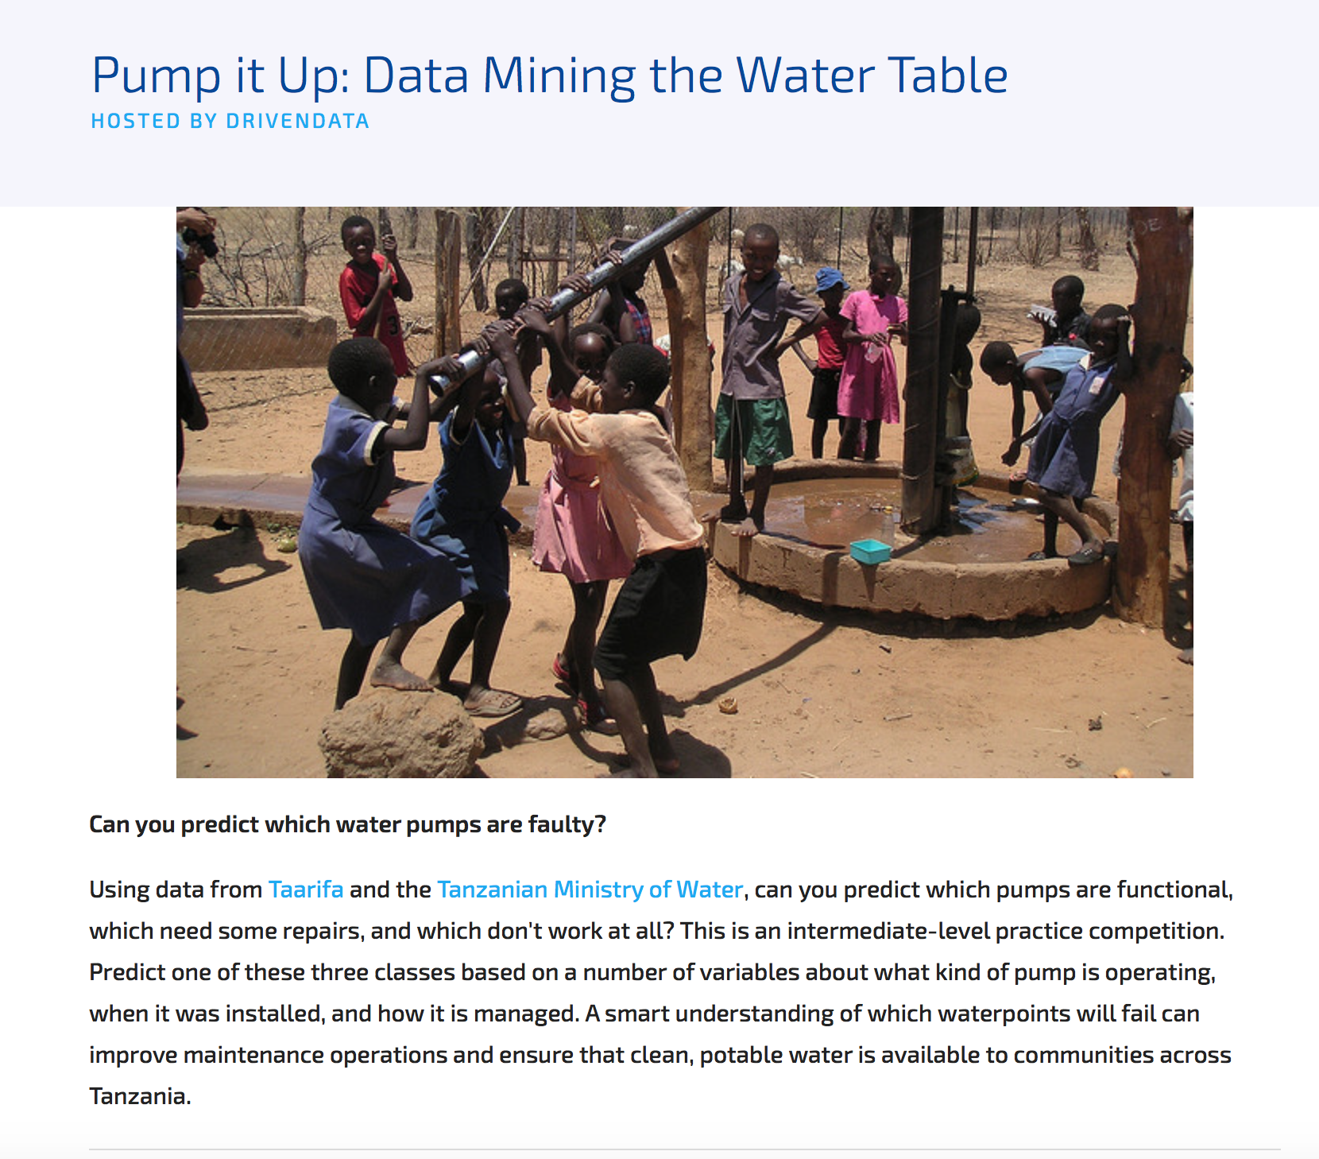
The Competition
Datadriven.com competition for the Glory!!!
~54,600 dataset to train and test
~15,000 dataset to classify and submit

Slide 3
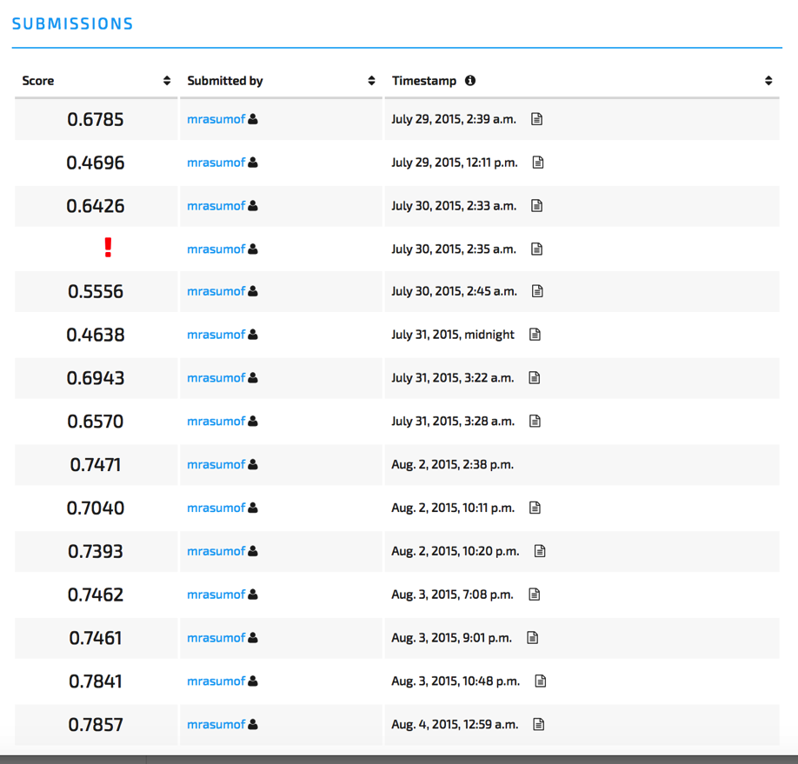
The Result
Approach:
started SIMPLE
Baby-steps improvements
Had fun and “enjoyed” the learning-curve
Stopped modeling when surpassed self-proposed goal
End-score 78.57% (top is 82.03%)

Slide 4

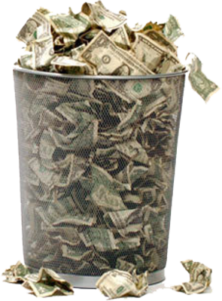
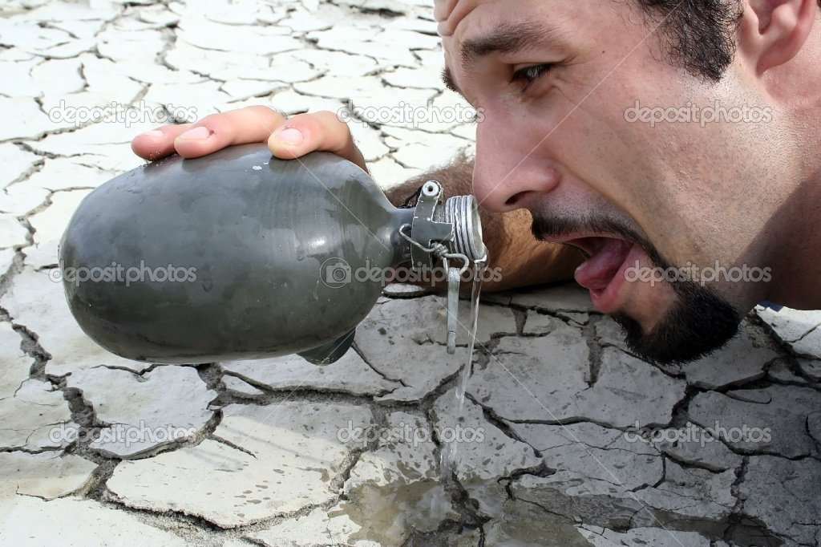


Modeling Focus
Business-case
 |  | Predicted
 |  | Function | Needs Repair | Don’t Function
True | Functions
 | Needs Repair
 | Don’t Function

Slide 5
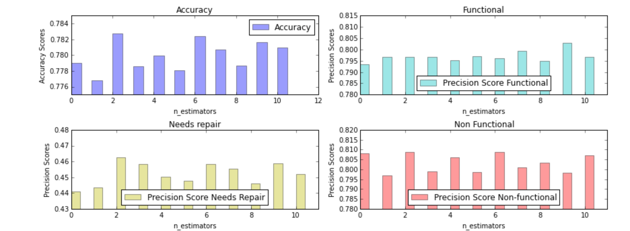
More Exploratory…

Slide 6
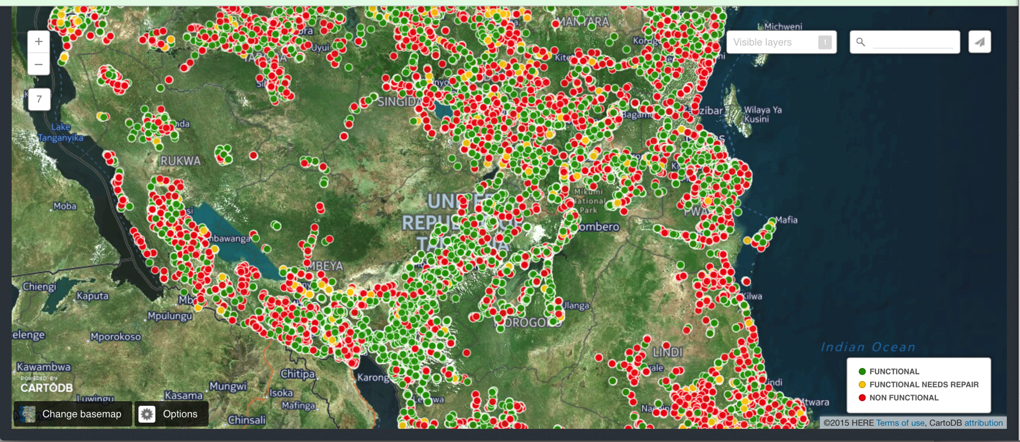
Exploratory Data Analysis
http://cdb.io/1EbrLrj

Slide 7
Modeling Approach
Simplest first step
Ran classifications models only with number field
Created dummies for all categorical data
Ran models again and pick best classifier algorithm
Fine-tuned by running simulations
Business-case orientation

Slide 8
The learning
Plan timeline and stick to it
Fine-tuning can be an infinite exercise
Take time to understand the output from the models
Define business-case in order to address the function objetive

Slide 9
Appendix

Slide 10
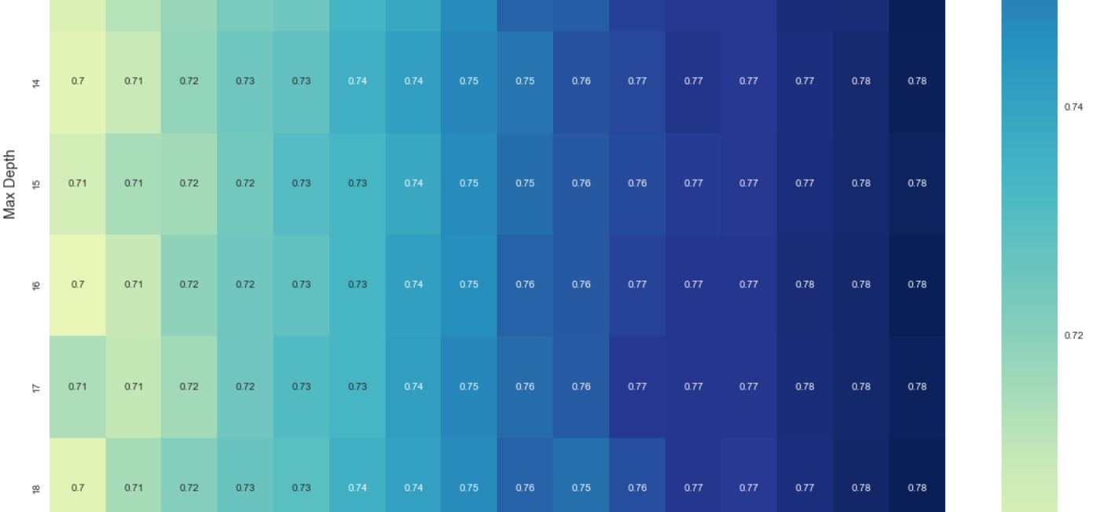
Simulated Models with different Parameters

Slide 11
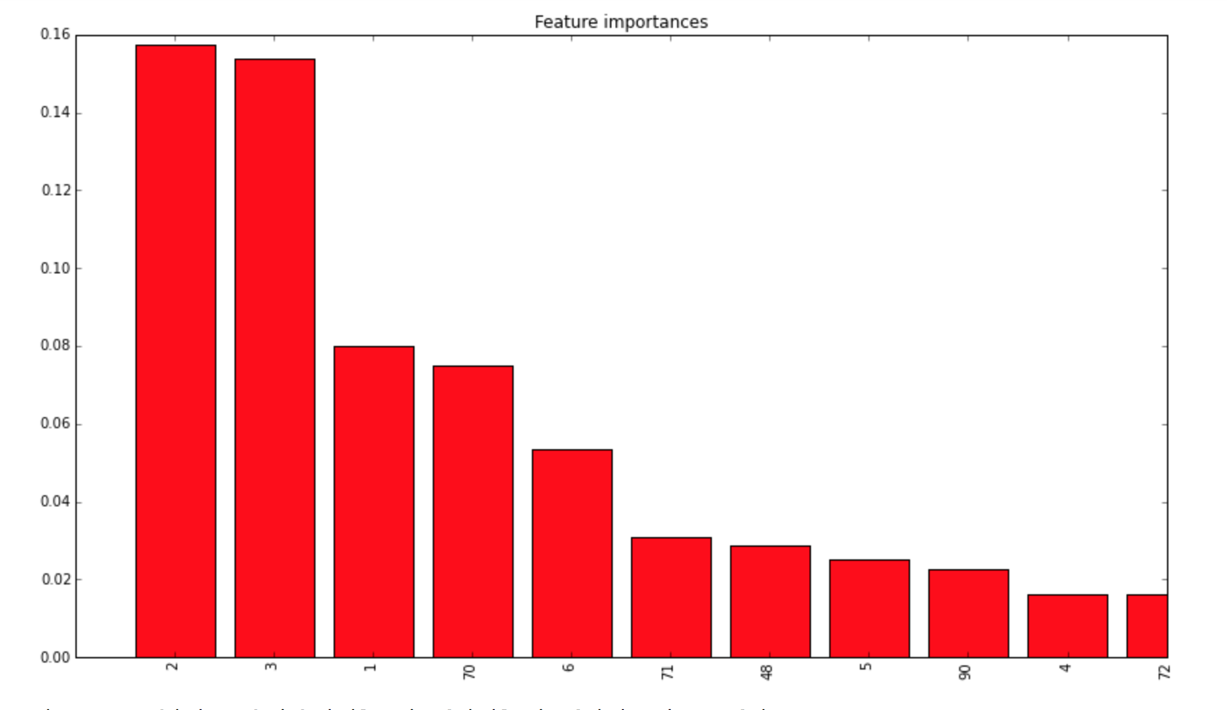
Feature Selection
Other

Slide 12
Feature Reduction
90
10

